Slide 1

Amazon Sales Analysis
Comprehensive Sales Data Review
By: Kaneez Masooma
Email: kaneezmasoomaofficial@gmail.com

Slide 2

Company Overview & Context
Company
Context
Amazon
Industry: E-commerce and Technology
Founded: 1994 by Jeff Bezos
Headquarters: Seattle, Washington, USA
Products and Services: Online retail, cloud computing, digital streaming, and artificial intelligence
Global Reach: Operations in numerous countries with a vast range of product categories
Amazon, the world's largest online retailer, has achieved significant success and growth in its sales across various regions, item types, and sales channels. This analysis focuses on Amazon's sales data from 2010 to 2017, providing a comprehensive review of the total revenue, units sold, costs, and profits. By examining these metrics, we can uncover trends, patterns, and insights that drive Amazon's business decisions and strategies.

Slide 3
Problem Statement
The Problem
Amazon's extensive sales data needs to be analyzed to uncover insights and trends across various regions, item types, and sales channels. Without this analysis, it is challenging to identify high-revenue areas, optimize inventory, and enhance sales strategies, leading to potential inefficiencies and missed opportunities.
Challenges Identified
- Uneven distribution of sales across regions and item types
- Need for better understanding of customer purchasing behavior
- Identification of peak sales periods and factors influencing them

Slide 4
Objective
Challenge 1
Challenge 3
Purpose
To conduct a detailed analysis of Amazon's sales data from 2010 to 2017, focusing on identifying key metrics and trends. The goal is to derive actionable insights that can help optimize inventory management, improve sales strategies, and identify top-performing regions and item types to drive business decisions.
- Revenue generation across different regions
- Item types contributing to sales
- Sales channels (online vs. offline)
Focus Areas
Tools & Libraries
Data Analysis: Python
Data Visualization: PowerBI
Libraries: Pandas, Matplotlib, Seaborn

Slide 5

Data Introduction
Data Coverage: Sales data from 2010 to 2017
Data Types:
Numerical: Revenue, Units Sold, Cost, Profit
Categorical: Region, Item Type, Sales Channel, Order Priority

Slide 6

Key Metrics to be Evaluated
Total Revenue
Total Units Sold
Total Profit
Total Cost
Revenue by Region
Revenue by Item Type
Revenue by Sales Channel
Units Sold by Item Type
Processing Time
Profit Margin

Slide 7

Data Attributes
Order Date: The date when the order was placed.
Ship Date: The date when the order was shipped.
Order ID: Unique identifier for each order.
Item Type: Type of item sold (e.g., Cosmetics, Baby Food, Office Supplies; Total 12)
Sales Channel: Channel through which the sale was made (Online or Offline).
Region: Geographical region where the order was placed.(Total 7)
Country: Country where the order was placed.(Total 76)
Units Sold: Number of units sold in the order.
Unit Price: Price per unit of the item.
Unit Cost: Cost per unit of the item.
Total Revenue: Total revenue generated from the order.
Total Cost: Total cost incurred for the order.
Total Profit: Profit generated from the order.
Order Priority: Priority level of the order (C - Critical, H - High, L - Low, M - Medium)

Slide 8

Engineered Features
Profit Margin: Total Profit / Total Revenue, indicating profitability of each sale.
Processing Time: Days taken to process the order (Ship Date - Order Date).
Order Month: Month in which the order was placed, for seasonality analysis.
Order Year: Year in which the order was placed, for trend analysis.

Slide 9

Data Analysis

Slide 10

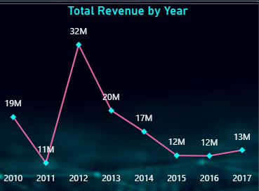
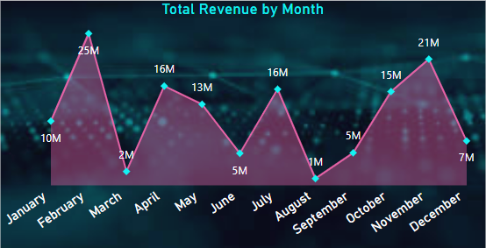
Overall Sales Overview
Total Revenue: $137.35M
Total Units Sold: 513K
Total Profit: $44.17M
Total Cost: $93.18M
- Revenue peaked in 2012 at $32M, with fluctuations observed in subsequent years.
- Revenue peaks in February and November, indicating seasonality in sales.

Slide 11
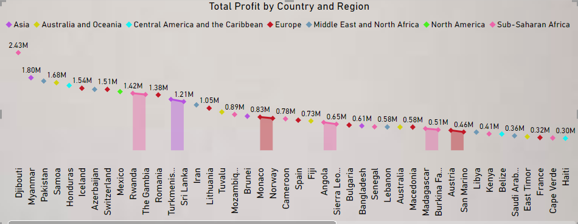
Profit Distribution by Region and Country
Top Countries by Profit: Djibouti, Myanmar, Pakistan, Samoa, Honduras, Iceland, Azerbaijan.
Leading Regions: Sub-Saharan Africa and Europe show the highest total profits.
Moderate Performers: Asia, Middle East and North Africa, Australia and Oceania, and Central America and the Caribbean.
Lowest Profit: North America indicates more localized economic contributions.

Slide 12
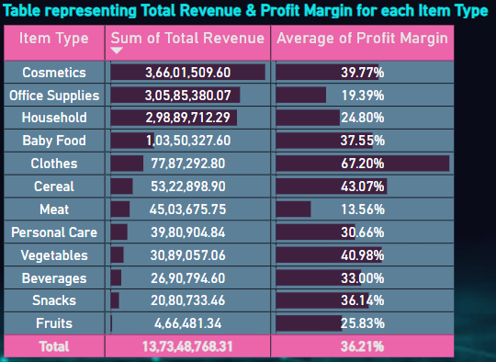
Profit Margin by Item Type
Cosmetics lead in revenue ($36.60M) but have a moderate profit margin (39.77%).
Clothes combine high profit margin (67.20%) with substantial revenue ($7.79M), making them highly profitable.
Office Supplies has low profit margin (19.39%) despite generating significant revenue ($30.58M).
Fruits ($0.47M) and Vegetables ($3.09M) have lower revenues but maintain modest profit margins (25.8% and 40.98%, respectively).

Slide 13
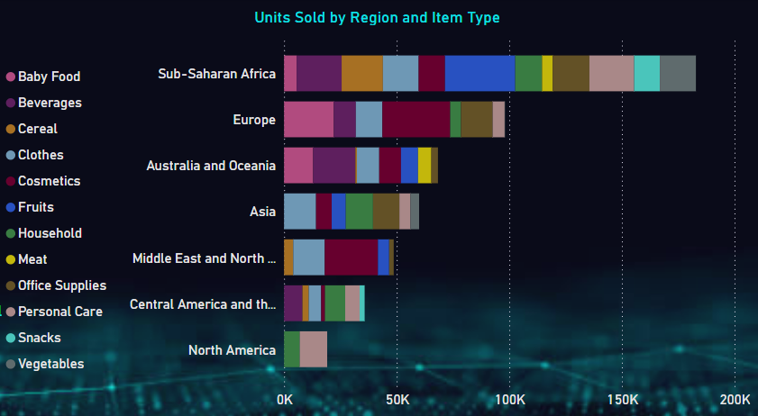
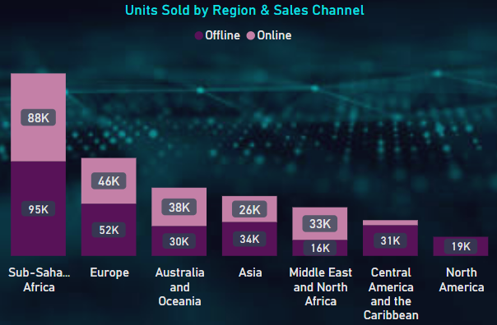
Sales by Items, Region and Sales Channel
Europe and Middle East & North Africa: Top cosmetic consumers.
Baby Food: Predominantly sold in Europe & Australia.
Fruits: Majorly sold in Sub-Saharan Africa.
Personal Care: Dominated by North America and Sub-Saharan Africa.
Sub-Saharan Africa: Leads in offline and online sales, followed by Europe.
Asia, North, and Central America: Potential for significant improvement in online sales.

Slide 14
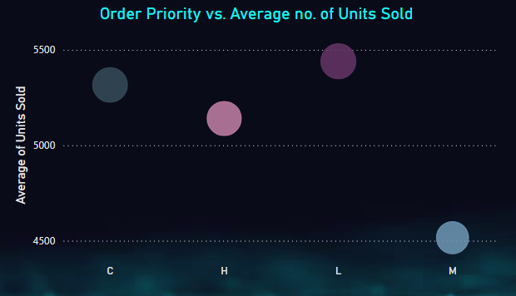
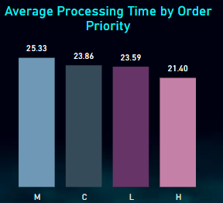
More Insights
High Processing Time for Medium Priority Orders: Despite having lower average order sizes, Baby Food and Clothes significantly increase the average processing time for medium priority orders. This indicates potential inefficiencies or complexities in handling these specific item types at this priority level.

Slide 15
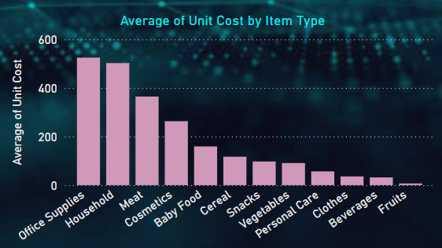
More Insights
High Unit Cost Items: Office Supplies, Household, Meat
Areas Requiring Further Research: Exploring unit cost dynamics through comparative analysis, seasonal variations, sustainability impact, risk management, customer insights, and future trends opens avenues for comprehensive research and strategic insights.

Slide 16
Strategic Suggestions for Sales Enhancement and Profit Optimization
Sales Channel Optimization: Exploring strategies to enhance online sales in Asia, North America, and Central America.
Profitability Analysis: Investigating reasons behind lower profit margins for high-revenue items like Office Supplies and Meat.
Regional Sales Trends: Understanding consumer preferences in key product sales regions (e.g., cosmetics in Europe, personal care in North America) to tailor marketing strategies and potentially improve regional sales.
Cost Efficiency Measures: Identifying opportunities to reduce unit costs for high-cost items such as Household and Office Supplies to achieve cost efficiencies.

Slide 17
Thank You!

